Slide 1
Chapter-02: Periodic Table
Classification of the element:
Nobel metal and base: In one of the earliest attempts at the classification, the metal were divided into two groups. Gold and silver were considered to be noble metals, whereas copper, iron, tin, and lead etc. were included among the base metals.
Dobereiner’s Triads: In 1829, J. W. Dobereiner observed that several of the element could be grouped together in sets of there, called triads, which have closely related properties. The triads are found to have either nearly the same atomic weights or differ by an almost constant difference. Using present-day atomic weights which are more accurate than those used by Dobereiner, the relationship among some triads may be shown as in table 4.2
Triads | ATOMIC WEIGHT | Difference between consecutive element
Li Na K | 6.940 22.997 39.100 | 16.057 16.103

Slide 2
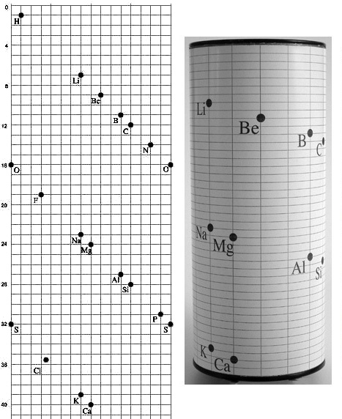
Triads | Atomic weight | Difference between consecutive element
Cl Br I | 35.457 79.916 126.91 | 44.459 46.994
Fe Co Ni | 55.85 58.94 58.71 | Almost the same at. Wt.
Figure: A portion of the Telluric Screw on a flat surface (heights proportional to
their atomic weight

Slide 3
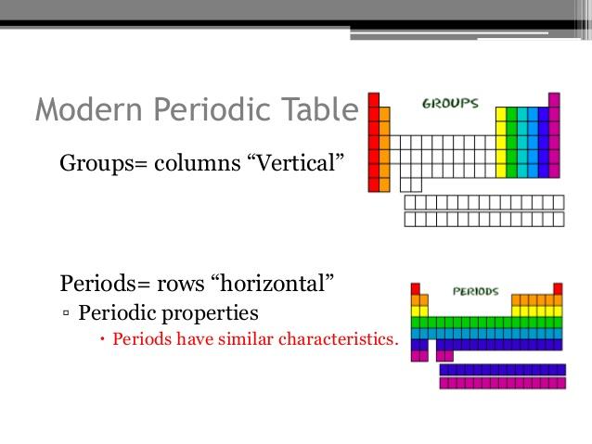
3. Law of Octaves: In 1864, John Newlands arranged the element in the increasing order of their atomic weight and observed that every eight element in the list beginning from any given element showed a repetition of the physical and chemical properties of the first element. Because of its resemblance with the eight notes in musical scale this concept of the classification of elements was known as the law of Octaves.
Periodic law:
Mendeleev’s Periodic Law - The physical and chemical properties of elements are the periodic function of their atomic weight.
Modern periodic law:
According to modern periodic law “The properties of elements are the periodic functions of their atomic numbers”.

Slide 4
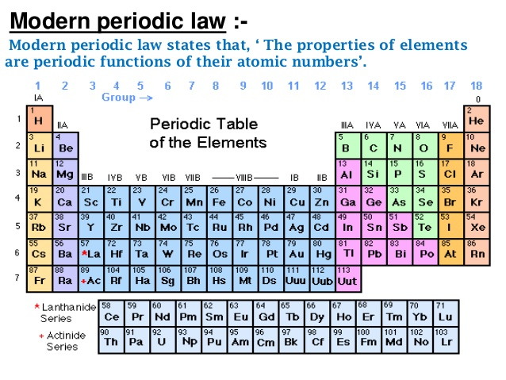
Elements 113, 115, 117, and 118 are now formally named nihonium (Nh), moscovium (Mc), tennessine (Ts), and oganesson (Og)

Slide 5
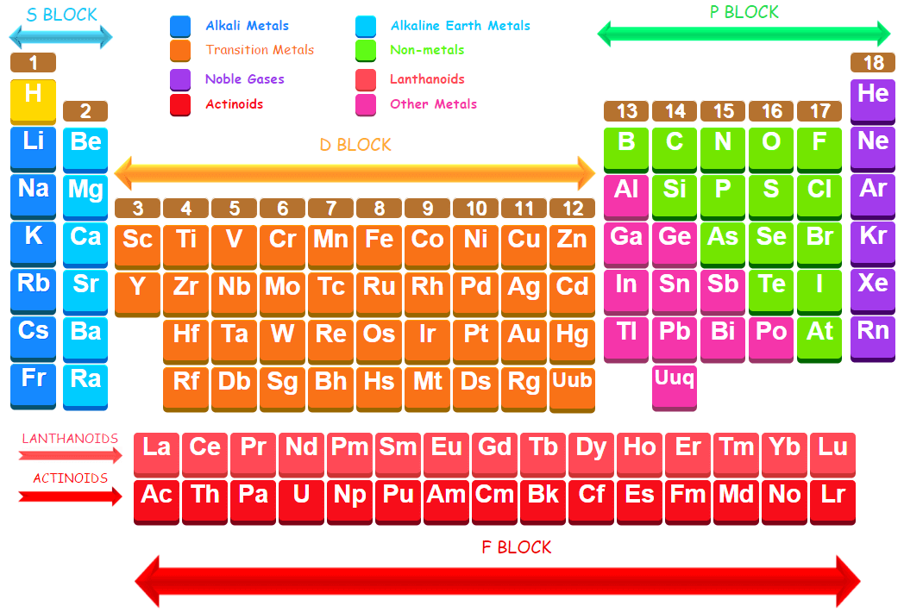

Slide 6
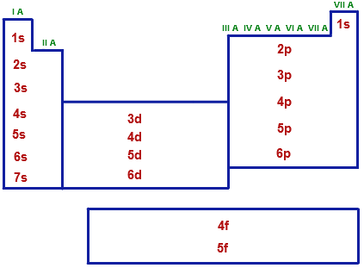
Classification of elements:
Elements are 4 types depending on the block in the periodic table.
(1). s-block elements: Elements of groups 1 and 2 including He in which the last electron enters the s-orbital of the valence shell are called s-block elements. There are only 14 s-block elements in the periodic table. Properties are:
1) They are soft metals with low melting and boiling points.
2) They have low ionization enthalpies and are highly electropositive.
3) They lose the valence electrons readily to form +1 and +2 ions.
4) They are very reactive metals . The metallic character and reactivity increases as we move down the group. Because of high reactivity, they are never found pure in nature.
5) The compounds of s-block elements with the exception of beryllium are predominantly ionic.
6) Most of the metal of this blog impart characteristic color to flame.
7) They are strong reducing agents.
8) All are good conductors of heat and electricity.

Slide 7
(2). p-block elements: Elements of groups 13–18 in which the last electron enters the p-orbitals of the valence shell are called p-block elements. The p-Block Elements comprise those belonging to Group 13 to 18 and these together with the s-Block Elements are called the Representative Elements or Main Group Elements.
Properties of p-Block elements: (contain p-electrons in their valence shell)
1) Most of p-Block elements are non-metals.
2) They have variable oxidation states.
3) They form acidic oxides
4) They impart no characteristic color to the flame
5) Generally they form covalent compounds. Halogens form salts with alkali metals
6)They have high ionization potentials.
7)They have very large electron gain enthalpies.
8)They are solids/liquids/gases at room temperature (Br is liquid)
9)The aqueous solutions their oxides are acidic in nature.
(3). d-block element: Properties of d-Block elements: (contain d-electrons in their valence shell).
1) These elements lie in between s-block and p-block elements. These elements are called transition elements as they show transitional properties between s and p-block elements. The general electronic configuration of d-block elements is (n-1)d¹⁻¹⁰ns⁰⁻².
2) Most of the d-block elements are metals.
3) Most of them exhibit variable oxidation states because of the presence of partly filled d-orbitals. (Except Sc, Zn, Cd etc.)

Slide 8
4) Many of their compounds are colored.
5) They readily form complexes by acting as Lewis acids.
6) They easily form complexes (colored).
7) Most of them and their compounds show paramagnetic, ferromagnetic behavior.
8) They act as good catalysts.
(4). f-Block elements are called inner-transition elements. In these elements, the f-subshell of the anti-penultimate is being progressively filled up. There are two series of f-block elements each containing 14 elements.
Electronic configuration: ns² (n-) d⁰⁻¹(n-2) f¹⁻¹⁴
1) f – block elements are also called as inner transition elements. They are: Lanthanides and actinides Lanthanides. (₅₈Ce- ₇₁Lu )
2) Actinides are the elements in which the last electron enters into 5f-orbital
3) All lanthanoids closely resemble lanthanum
4) Lanthanides are chemically similar to each other
5) Except for cerium (III and IV) and europium (III and II), the lanthanides occur as trivalent cations in nature.
6) Most lanthanides are widely used in lasers
7) These elements deflect UV and Infrared electromagnetic radiation and are commonly used in the production of sunglass lenses.
8) The ionic radii of the lanthanoids decrease through the period — the so called lanthanide contraction

Slide 9
Actinides ( ₉₀Th– ₁₀₃Lr):
1. All the actinides are radioactive
2. These are highly electro-positive ( show+3,+4,+5,+6 oxidation states)
3. These metals tarnish in air
4. They have number of isotopes.
5. They react with boiling water or dilute acids to give H₂ gas.
6. These directly combine with non-metals.
Similarities between Lanthanides and Actinides:
1. Both lanthanides and Actinides show +3 oxidation states
2. Both are electropositive and very reactive
3. Both are paramagnetic
DEFECTS OF LONG FORM OF PERIODIC TABLE
The position of hydrogen is still disputable as it was there in Mendeleev’s periodic table in group IA as well as IVA &VIIA.
Helium is an inert gas but its configuration is different from that of the other inert gas elements
Lanthanide and actinide series could not be adjusted in the main periodic table and therefore they had to be placed in a separate block below the periodic table.

Slide 10
The shielding effect describes the attraction between an electron and the nucleus in any atom with more than one electron. The shielding effect can be defined as a reduction in the effective nuclear charge on the electron cloud, due to a difference in the attraction forces of the electrons in the nucleus. It is also referred to as the screening effect (or) atomic shielding.
In hydrogen, or any other atom in group 1A of the periodic table (those with only one valence electron), the force on the electron is just as large as the electromagnetic attraction from the nucleus. However, when more electrons are involved, each electron (in the nth-shell) experiences not only the electromagnetic attraction from the positive nucleus, but also repulsion forces from other electrons in shells from 1 to n. This causes the net force on electrons in outer shells to be significantly smaller in magnitude; therefore, these electrons are not as strongly bonded to the nucleus as electrons closer to the nucleus. This phenomenon is often referred to as the orbital penetration effect. The shielding theory also contributes to the explanation of why valence-shell electrons are more easily removed from the atom.
The effective nuclear charge is the net charge an electron experiences in an atom with multiple electrons. The effective nuclear charge may be approximated by the equation:
Zeff = Z - S
Where Z is the atomic number and S is the number of shielding electrons

Slide 11
Periodic Properties: Properties which are directly or indirectly related to their electronic configuration and show a regular gradation (order) when we move from left to right in a period or from top to bottom in a group are called periodic properties. Some important periodic properties are:
a. atomic size
b. ionization energy
c. electron affinity
d. electronegativity
e. valency
f. density
g. atomic volume
h. melting and boiling points etc.
Atomic Radius
The atomic radius of an element is half of the distance between the centers of two atoms of that element that are just touching each other.
Generally, the atomic radius decreases across a period from left to right and increases down a given group. The atoms with the largest atomic radii are located in Group I and at the bottom of groups.
Moving from left to right across a period, electrons are added one at a time to the outer energy shell.

Slide 12
Moving from left to right across a period, electrons are added one at a time to the outer energy shell.
Electrons within a shell cannot shield each other from the attraction to protons. Since the number of protons is also increasing, the effective nuclear charge increases across a period. This causes the atomic radius to decrease.
Moving down a group in the periodic table, the number of electrons and filled electron shells increases, but the number of valence electrons remains the same. The outermost electrons in a group are exposed to the same effective nuclear charge, but electrons are found farther from the nucleus as the number of filled energy shells increases. Therefore, the atomic radii increase.
Ionization Energy
The ionization energy, or ionization potential, is the energy required to completely remove an electron from a gaseous atom or ion. The closer and more tightly bound an electron is to the nucleus, the more difficult it will be to remove, and the higher its ionization energy will be. The first ionization energy is the energy required to remove one electron from the parent atom. The second ionization energy is the energy required to remove a second valence electron from the univalent ion to form the divalent ion, and so on. Successive ionization energies increase. The second ionization energy is always greater than the first ionization energy.
Ionization energies increase moving from left to right across a period (decreasing atomic radius). Ionization energy decreases moving down a group (increasing atomic radius). Group I elements have low ionization energies because the loss of an electron forms a stable octet.

Slide 13
Electron Affinity
Electron affinity reflects the ability of an atom to accept an electron. It is the energy change that occurs when an electron is added to a gaseous atom. Atoms with stronger effective nuclear charge have greater electron affinity. Some generalizations can be made about the electron affinities of certain groups in the periodic table. The Group IIA elements, the alkaline earths, have low electron affinity values. These elements are relatively stable because they have filled s subshells. Group VIIA elements, the halogens, have high electron affinities because the addition of an electron to an atom results in a completely filled shell.
Group VIII elements, noble gases, have electron affinities near zero since each atom possesses a stable octet and will not accept an electron readily. Elements of other groups have low electron affinities.
In a period, the halogen will have the highest electron affinity, while the noble gas will have the lowest electron affinity. Electron affinity decreases moving down a group because a new electron would be further from the nucleus of a large atom.

Slide 14
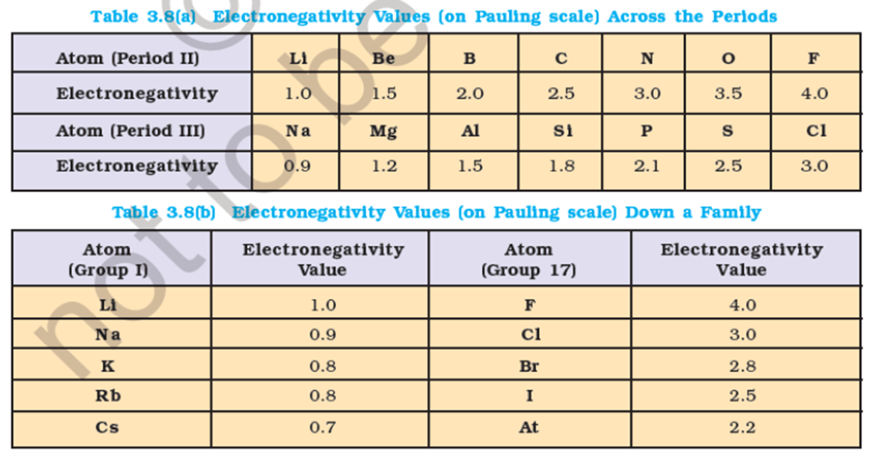
Electronegativity:
Electronegativity is a measure of the attraction of an atom for the electrons in a chemical bond. The higher the electronegativity of an atom, the greater its attraction for bonding electrons. Electronegativity is related to ionization energy. Electrons with low ionization energies have low electro negativities because their nuclei do not exert a strong attractive force on electrons. Elements with high ionization energies have high electronegativities due to the strong pull exerted on electrons by the nucleus. In a group, the electronegativity decreases as atomic number increases, as a result of increased distance between the valence electron and nucleus (greater atomic radius). An example of an electropositive (i.e., low electronegativity) element is cesium; an example of a highly electronegative element is fluorine.

Slide 15
Ionization energy is the energy required to remove an electron from a gaseous atom or ion. The first or initial ionization energy or Ei of an atom or molecule is the energy required to remove one mole of electrons from one mole of isolated gaseous atoms or ions.
Electron affinity reflects the ability of an atom to accept an electron. It is the energy change that occurs when an electron is added to a gaseous atom. Atoms with stronger effective nuclear charge have greater electron affinity.
The reaction that occurs when an atom takes an electron may be represented as:
X + e− → X− + energy
Another way to define electron affinity is as the amount of energy needed to remove an electron from a singly charged negative ion:
X⁻ → X + e⁻
Electronegativity is a measure of the tendency of an atom to attract a bonding pair of electrons. The Pauling scale is the most commonly used. Fluorine (the most electronegative element) is assigned a value of 4.0, and values range down to caesium and francium which are the least electronegative at 0.7.

Slide 16
Summary of Periodic Properties of Elements
Moving Left → Right
Atomic Radius Decreases
Ionization Energy Increases
Electron Affinity Generally Increases (except Noble Gas Electron Affinity Near Zero)
electronegativity increase
Moving Top → Bottom
Atomic Radius Increases
Ionization Energy Decreases
Electron Affinity Generally Decreases Moving Down a Group
Electronegativity Decreases

Slide 17
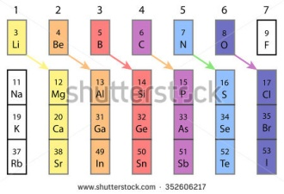
Diagonal Relationships
A Diagonal Relationship is said to exist between certain pairs of diagonally adjacent elements in the second and third periods of the periodic table. These pairs (Li & Mg, Be & Al, B & Si etc.) exhibit similar properties; for example, Lithium, a member of the alkali metal of group 1A in some respects resembles magnesium of group IIA. Thus, Lithium salts usually occur in hydrated from unlike other alkali metal salts. Moreover, unlike other alkali metal carbonates and phosphates Li2CO3 and Li3PO4 are insoluble in water, as are the corresponding magnesium carbonate and phosphate. Lithium is the only alkali metal to form ionic lithium nitride, Li3N, like magnesium nitride. Thus, Li of group IA resembles Mg of group IIA in many respects contrary to its group properties. Similar relationship exists between the three elements, beryllium of group IIA, aluminum of group IIIA. Boron of group IIIA shows likeness with silicon of group IVA. Thus, the light elements of the following groups. The similarity referred to as diagonal relationship in the Periodic Tables as shown below.

Slide 18
Group 18: Properties of Nobel Gases
The noble gases (Group 18) are located in the far right of the periodic table and were previously referred to as the "inert gases" due to the fact that their filled valence shells (octets) make them extremely nonreactive. The noble gases were characterized relatively late compared to other element groups.
The History
The first person to discover the noble gases was Henry Cavendish in the late 180th century. Cavendish distinguished these elements by chemically removing all oxygen and nitrogen from a container of air. The nitrogen was oxidized to NO2 by electric discharges and absorbed by a sodium hydroxide solution. The remaining oxygen was then removed from the mixture with an absorber. The experiment revealed that 1/120 of the gas volume remained un-reacted in the receptacle. The second person to isolate, but not typify, them was William Francis (1855-1925). Francis noted the formation of gas while dissolving uranium minerals in acid.
The Electron Configurations for Noble Gases
Helium 1s²
Neon [He] 2s² 2p⁶
Argon [Ne] 3s² 3p⁶
Krypton [Ar] 3d¹⁰ 4s² 4p⁶
Xenon [Kr] 4d¹⁰ 5s² 5p⁶
Radon [Xe] 4f¹⁴ 5d¹⁰ 6s² 6p⁶

Slide 19
Table 1: Trends within Group 18
Atom | Atomic number | Atomic mass | Boiling point (K) | Melting point (K) | 1st Ionization (E/kJ mol⁻¹ | Density (g/dm³) | Atomic radius (pm)
He | 2 | 4.003 | 4.216 | 0.95 | 2372.3 | 0.1786 | 31
Ne | 10 | 20.18 | 27.1 | 24.7 | 2080.6 | 0.9002 | 38
Ar | 18 | 39.948 | 87.29 | 83.6 | 1520.4 | 1.7818 | 71
Kr | 36 | 83.3 | 120.85 | 115.8 | 1350.7 | 3.708 | 88
Xe | 54 | 131.29 | 166.1 | 161.7 | 1170.4 | 5.851 | 108
Rn | 86 | 222.1 | 211.5 | 202.2 | 1037.1 | 9.97 | 120

Slide 20
The Atomic and Physical Properties
Atomic mass, boiling point, and atomic radii INCREASE down a group in the periodic table.
The first ionization energy DECREASES down a group in the periodic table.
The noble gases have the largest ionization energies, reflecting their chemical inertness.
Down Group 18, atomic radius and interatomic forces INCREASE resulting in an INCREASED melting point, boiling point, enthalpy of vaporization, and solubility.
The INCREASE in density down the group is correlated with the INCREASE in atomic mass.
Because the atoms INCREASE in atomic size down the group, the electron clouds of these non polar atoms become increasingly polarized, which leads to weak van Der Waals forces among the atoms. Thus, the formation of liquids and solids is more easily attainable for these heavier elements because of their melting and boiling points.
Because noble gases’ outer shells are full, they are extremely stable, tending not to form chemical bonds and having a small tendency to gain or lose electrons.
Under standard conditions all members of the noble gas group behave similarly.
All are monotomic gases under standard conditions.
Noble gas atoms, like the atoms in other groups, INCREASE steadily in atomic radius from one period to the next due to the INCREASING number of electrons.
The size of the atom is positively correlated to several properties of noble gases. The ionization potential DECREASES with an INCREASING radius, because the valence electrons in the larger noble gases are further away from the nucleus; they are therefore held less tightly by the atom.
The attractive force INCREASES with the size of the atom as a result of an INCREASE in polarizability and thus a DECREASE in ionization potential.
.

Slide 21
Applications of Noble Gases
Helium
Helium is used as a component of breathing gases due to its low solubility in fluids or lipids. This is important because other gases are absorbed by the blood and body tissues when under pressure during scuba diving. Because of its reduced solubility, little helium is taken into cell membranes; when it replaces part of the breathing mixture, helium causes a decrease in the narcotic effect of the gas at far depths. The reduced amount of dissolved gas in the body means fewer gas bubbles form, decreasing the pressure of the ascent. Helium and Argon are used to shield welding arcs and the surrounding base metal from the atmosphere.
Helium is used in very low temperature cryogenics, particularly for maintaining superconductors (useful for creating strong magnetic fields) at a very low temperatures. Helium is also the most common carrier gas in gas chromatography.
Neon
Neon has many common and familiar applications: neon lights, fog lights, TV cine-scopes, lasers, voltage detectors, luminous warnings, and advertising signs. The most popular application of neon is the neon tubing used in advertising and elaborate decorations. These tubes are filled with neon and helium or argon under low pressure and submitted to electrical discharges..

Slide 22
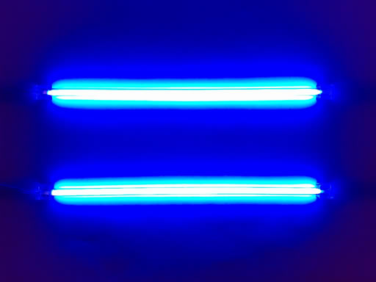
The color of emitted light is depends on the composition of the gaseous mixture and on the color of the glass of the tube. Pure Neon within a colorless tube absorbs red light and reflects blue light, as shown in the figure below. This reflected light is known as fluorescent light.
One of the many colors of neon lights

Slide 23
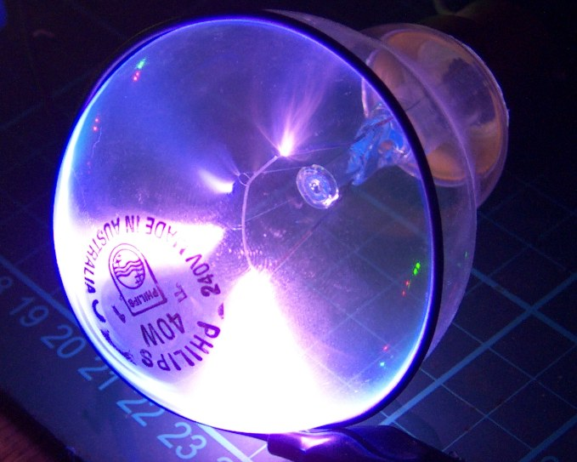
Argon
Argon has a large number of applications in electronics, lighting, glass, and metal fabrications. Argon is used in electronics to provide a protective heat transfer medium for ultra-pure silicon crystal semiconductors and for growing germanium. Argon can also fill fluorescent and incandescent light bulbs, creating the blue light found in "neon lamps." By utilizing argon's low thermal conductivity, window manufacturers provide a gas barrier needed to produce double-pane insulated windows. This insulation barrier improves the windows' energy efficiencies. Argon also creates an inert gas shield during welding, flushes out melted metals to eliminate porosity in casting, and provides an oxygen- and nitrogen-free environment for annealing and rolling metals and alloys.
Argon plasma light bulb

Slide 24

Krypton
Similarly to argon, krypton can be found in energy efficient windows. Because of its superior thermal efficiency, krypton is sometimes chosen over argon for insulation. It is estimated that 30% of energy efficient windows sold in Germany and England are filled with krypton; approximately 1.8 liters of krypton are used in these countries. Krypton is also found in fuel sources, lasers and headlights. In lasers, krypton functions as a control for a desired optic wavelength. It is usually mixed with a halogen (most likely fluorine) to produce excimer lasers. Halogen sealed beam headlights containing krypton produce up to double the light output of standard headlights. In addition, Krypton is used for high performance light bulbs, which have higher color temperatures and efficiency because the krypton reduces the rate of evaporation of the filament.
Krypton laser.

Slide 25
Xenon
Xenon has various applications in incandescent lighting, x-ray development, plasma display panels (PDPs), and more. Incandescent lighting uses xenon because less energy can be used to obtain the same light output as a normal incandescent lamp. Xenon has also made it possible to obtain better x-rays with reduced amounts of radiation. When mixed with oxygen, it can enhance the contrast in CT imaging. These applications have had great impact on the health care industries. Plasma display panels (PDPs) using xenon as one of the fill gases may one day replace the large picture tubes in television and computer screens.
Nuclear fission products may include several radioactive isotopes of xenon, which absorb neutrons in nuclear reactor cores. The formation and elimination of radioactive xenon decay products are factors in nuclear reactor control.
Radon
Radon is reported as the second most frequent cause of lung cancer, after cigarette smoking. However, it also has beneficial applications in radiotherapy, arthritis treatment, and bathing. In radiotherapy, radon has been used in implantable seeds, made of glass or gold, primarily used to treat cancers. It has been said that exposure to radon mitigates auto-immune diseases such as arthritis. Some arthritis sufferers have sought limited exposure to radioactive mine water and radon to relieve their pain. "Radon Spas" such as Bad Gastern in Austria and Onsen in Japan offer a therapy in which people sit for minutes to hours in a high-radon atmosphere, believing that low doses of radiation will boost up their energy

